Slide 1
How to search rider records in usef
Instructions and Tutorial
Education Committee 2019

Slide 2
Log in to Usef.org

Slide 3
Click on “compete”

Slide 4
Click on “search people”

Slide 5
Enter rider’s name and click “search”

Slide 6
Click on rider’s name

Slide 7
Check “start date”

Slide 8
Change start date to earlier year

Slide 9
After changing start date, Click “update results”

Slide 10
Click “rider report”

Slide 11
Use “rider report” to count blue ribbons over fences and in equitation on the flat

Slide 12
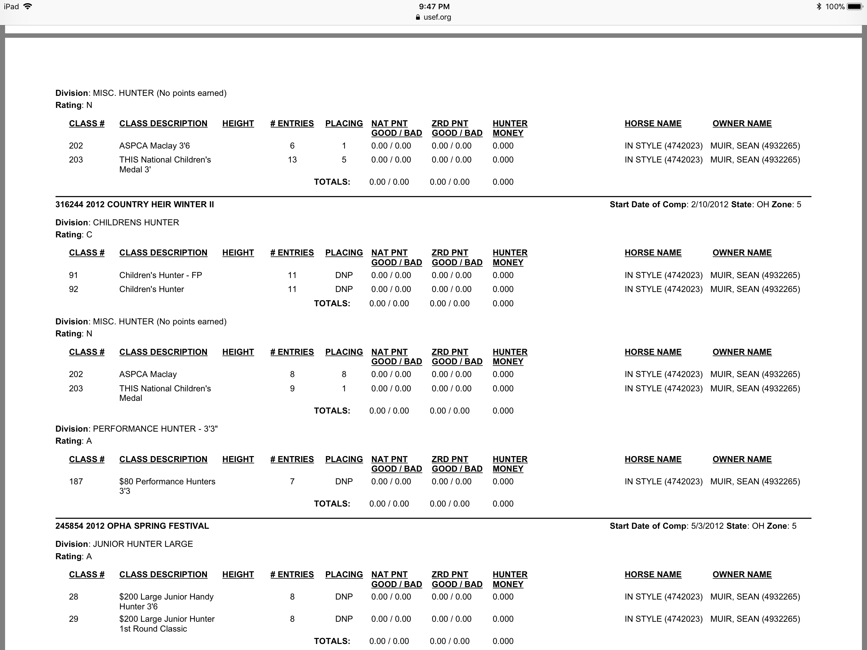
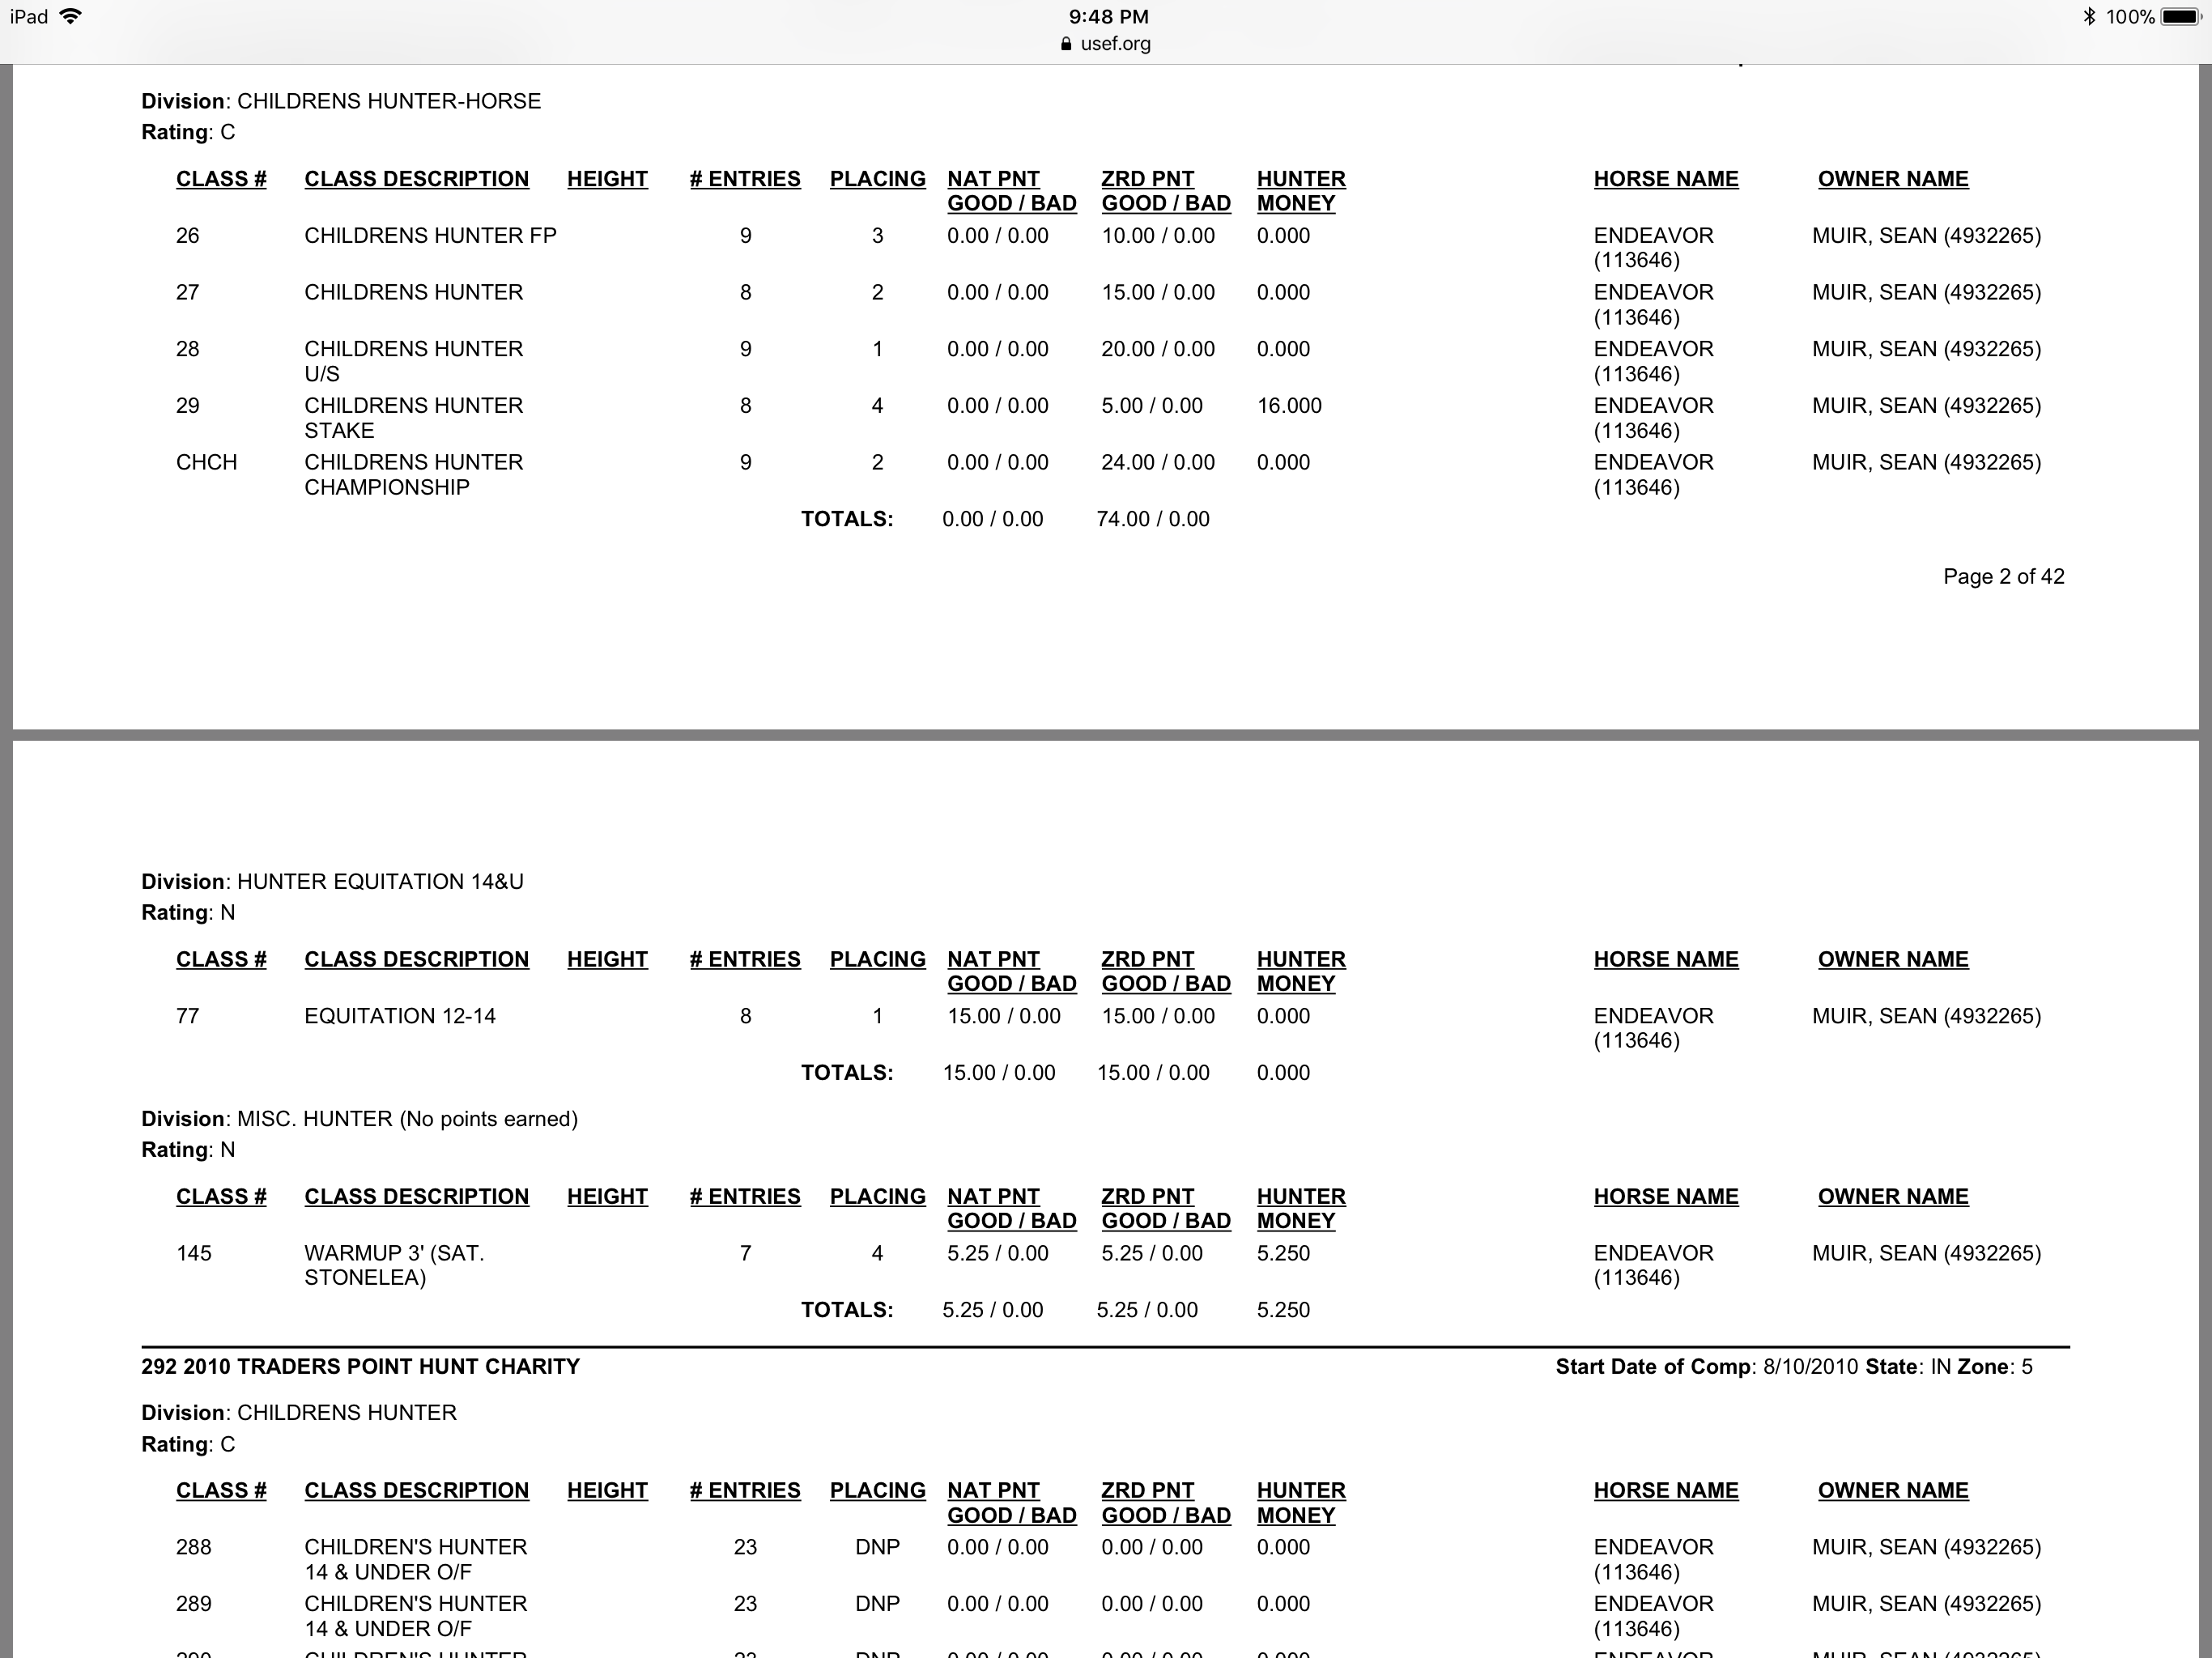
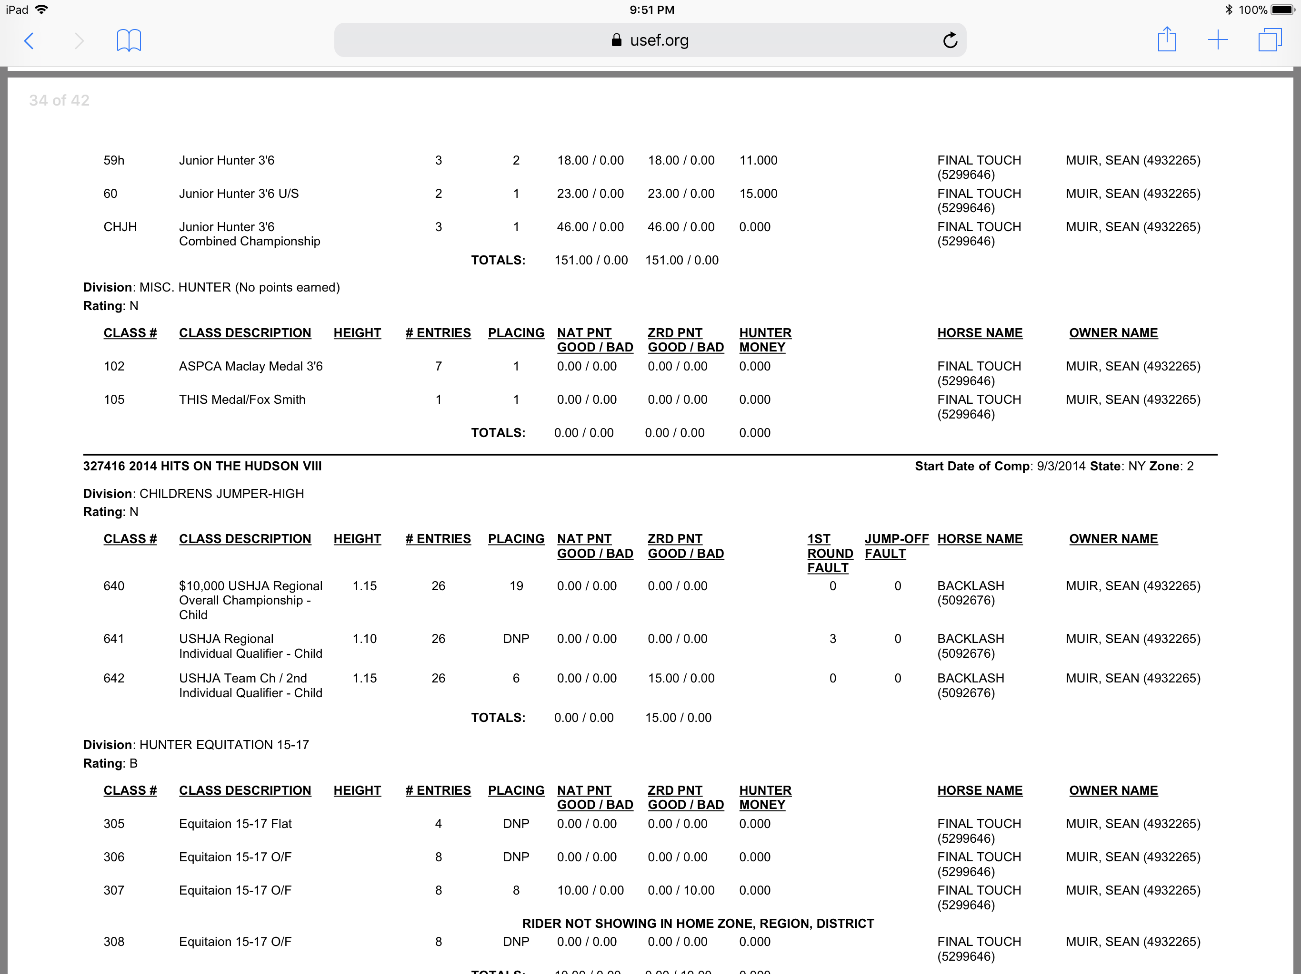

Slide 13
Current fan membership (non competing) – investigate for any past competition membership

Slide 14
Be sure to change start date to find the full record

Slide 15
Turns out she has a rider record!

Slide 16
Riders with no records usually place into 2B or lower but check social media as well

